Slide 1
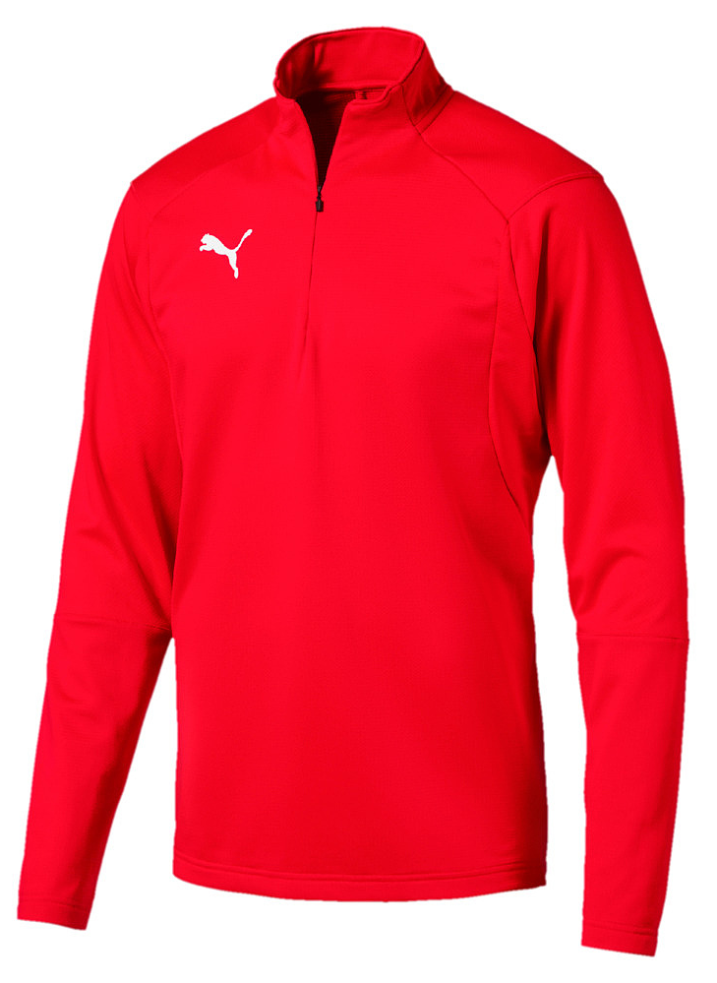
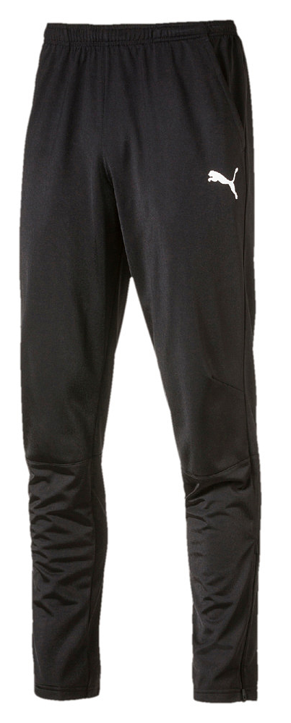

Vedums AIS
Tränings overall
Liga training ¼ zip SR: 310Kr
Liga training ¼ zip JR: 280Kr
Liga training pant SR: 280Kr
Liga training pant JR: 240Kr

Slide 2
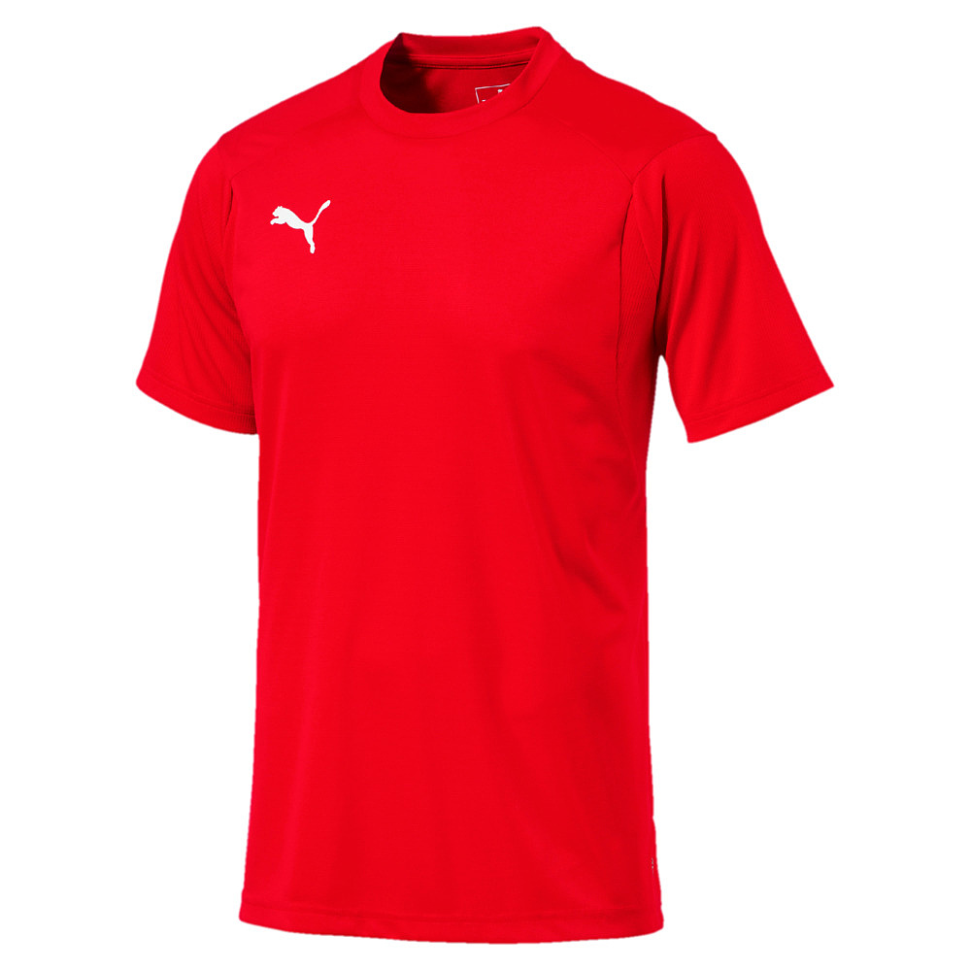
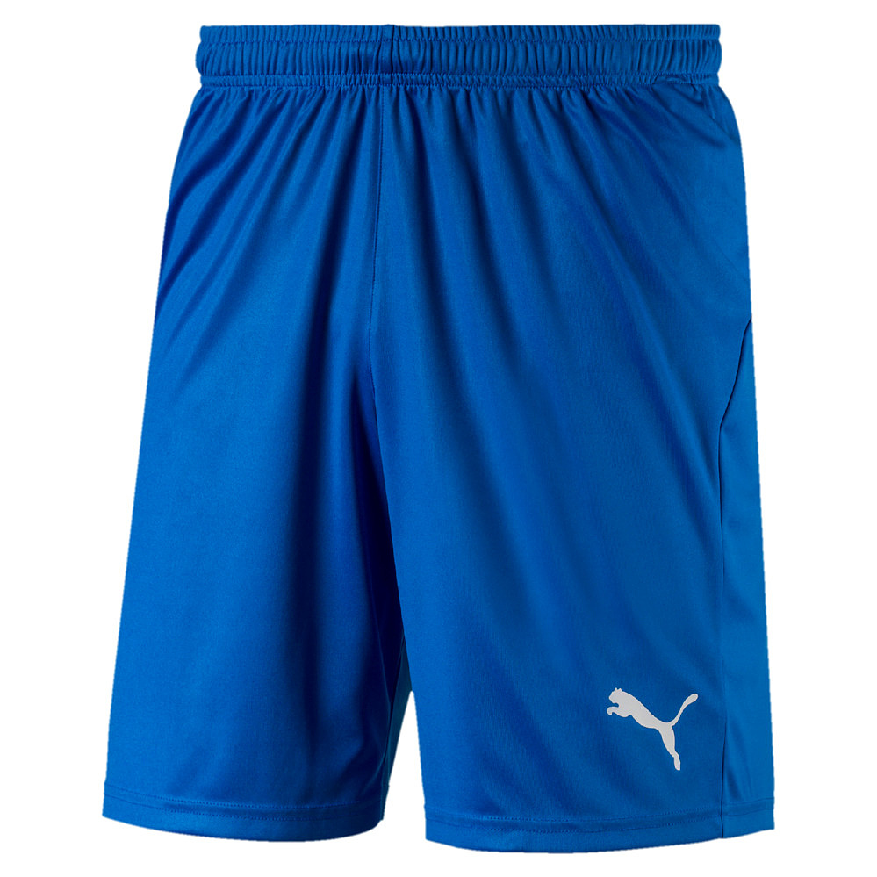
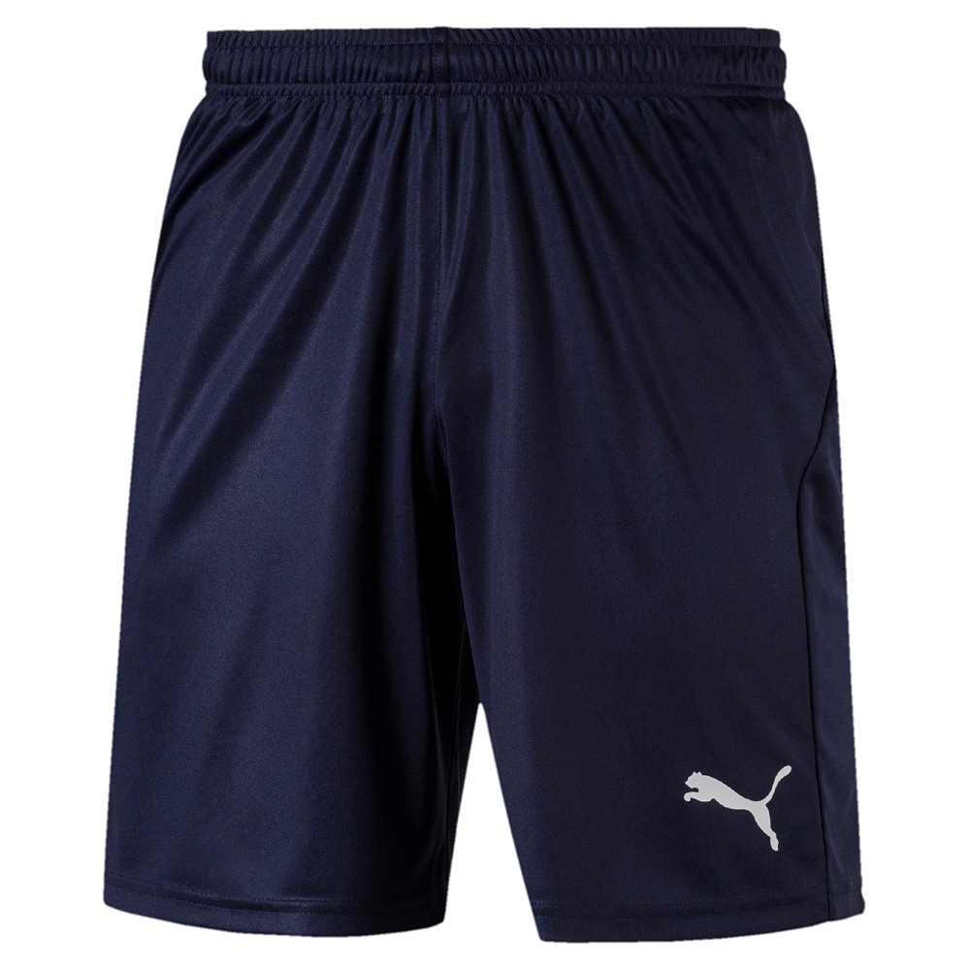
Vedums AIS
Tränings kit
Training jersy SR: 170kr
Training jersy JR: 135kr
Liga Core shorts SR: 135kr
Liga Core shorts JR: 125kr
Fotbollsstrumpa: 70:-

Slide 3
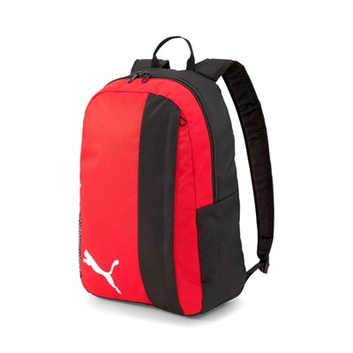
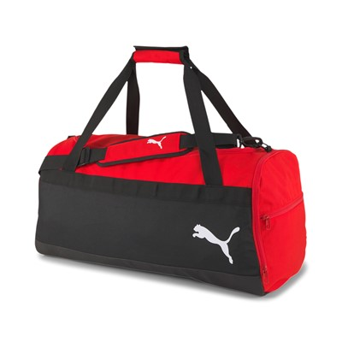
Vedums AIS
Väskor
Pro training medium bag: 240Kr
Pro training backpack: 190Kr
Namntryck litet 35:-/st
Ryggtryck 50:-/st

